Slide 1

From Books to Movies
Natasha Borders

Slide 2
Objective
For movies which are based on books, does the book success translate into movie success?
Notes:
When looking at the book rating versus movie rating, does the success of the book explain the success of the movie?

Slide 3
Design and data acquisition
Book Data
Goodreads
Movie Data
IMDb
Analysis
MovieLens
Linear Regression
K-means Cluster
Ridge Regression
Notes:
I did a combination of scraping and using the API across Goodreads, IMDb and Movie Lens.
After the initial look at the variables, discovered that several were highly skewed, so I performed polynomial and log transformations, after which I analyzed using Linear and Ridge regression as well as K-means cluster analysis

Slide 4
What are the top five rated books?

Slide 5
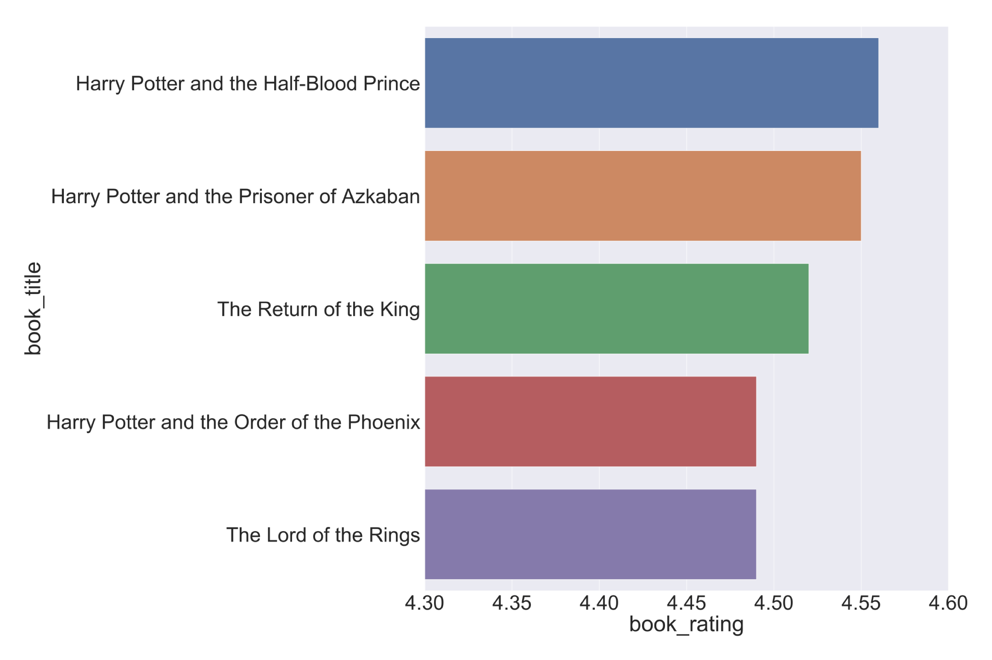

Slide 6
Five Top rated movies?

Slide 7
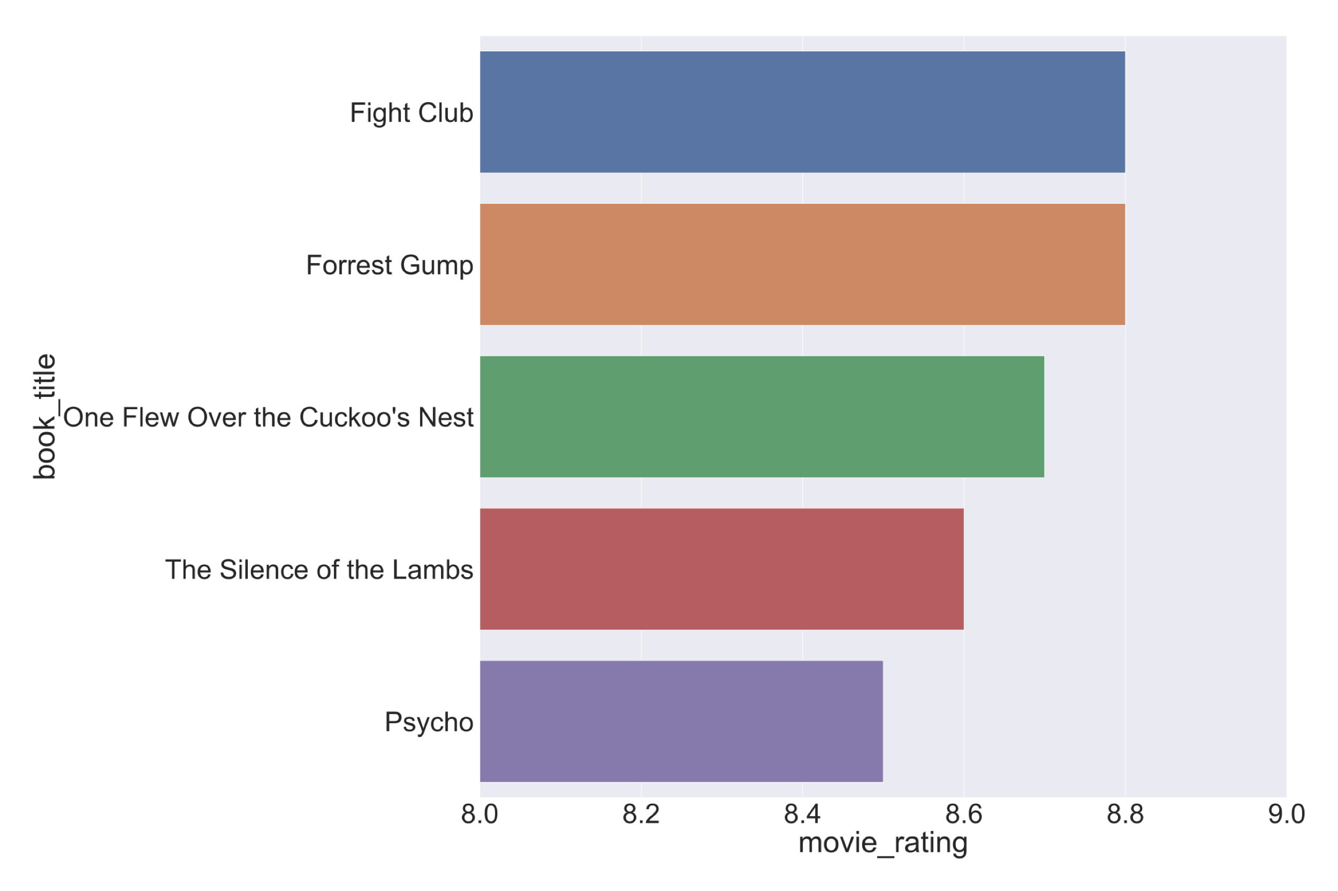

Slide 8
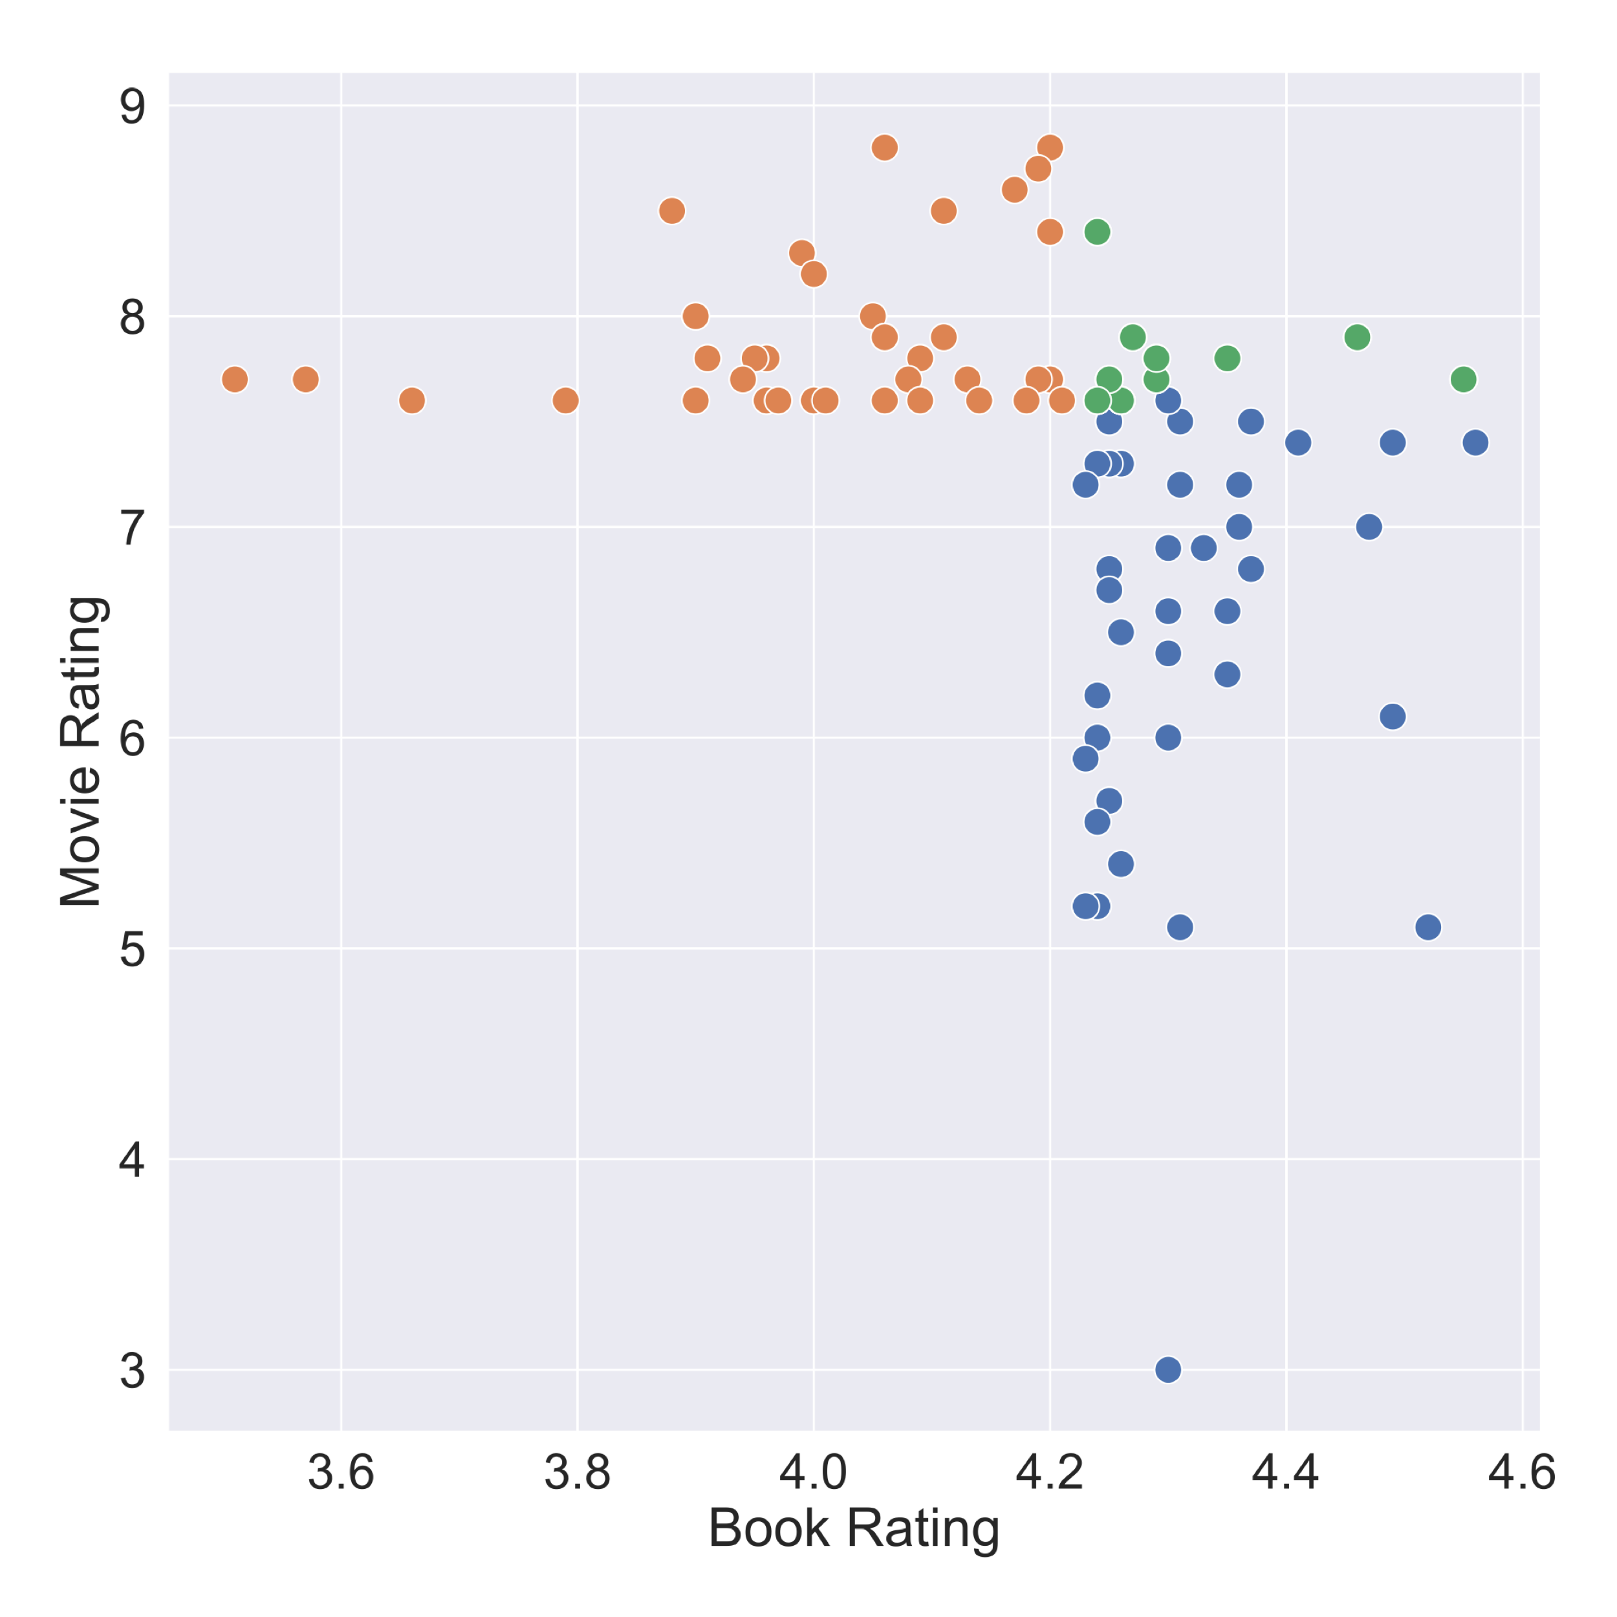
Why?
Top 50 movies
Cult classics – status achieved over time
Popular books produce good-enough movies
Top 50 books
Notes:
Top movies are produced from books ranging from adequate to great, whereas the best books produce good enough movies, but not necessarily the best. It seems that some lesser liked books produced into good movies gain traction as cult classics, but the book remains forgotten. When the book itself is a hit, such as HP or LotR, the movies are well-received but don’t seem to stand as well on their own.

Slide 9
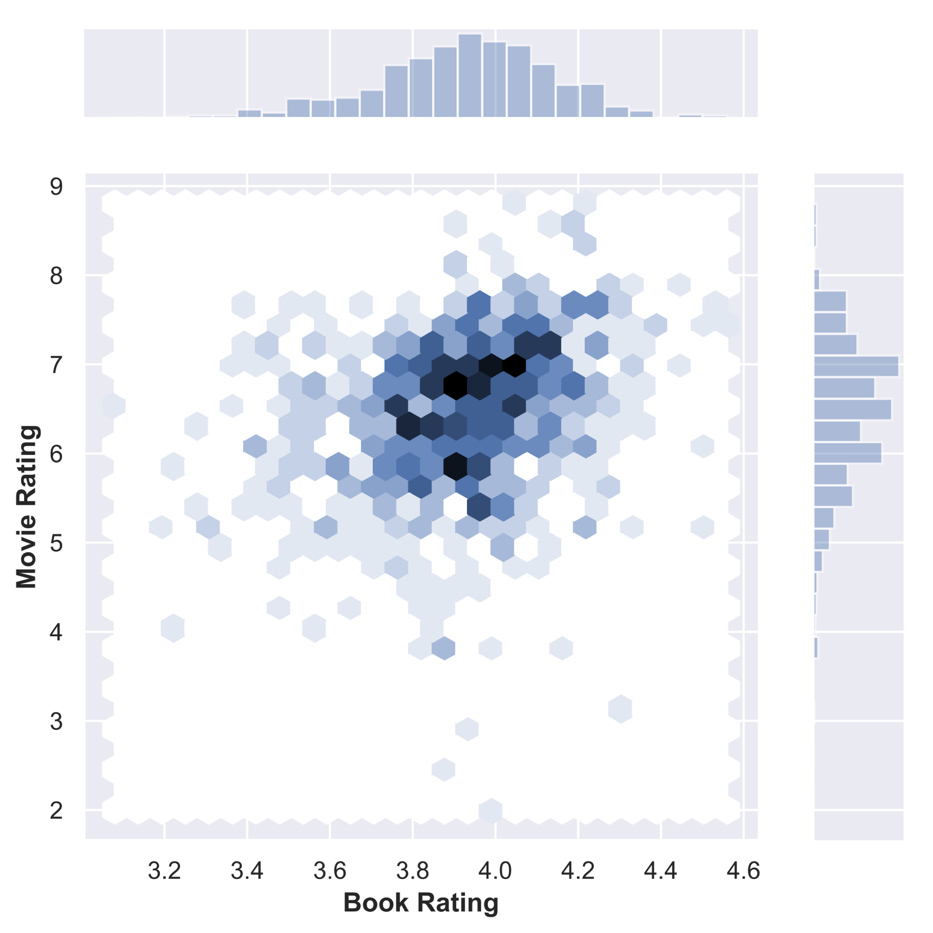
Book versus movie rating correlation
Weak positive correlation
Plenty of outliers like Fight Club
Self-selecting:
No worst or best in class
Notes:
Weak positive correlation – however, it’s notable that the book rating only varies between 3 and high fours in rating, while the movie rating varies between 2 all the way through 9. this means that in order to be made into a movie, the book already has to be at least decent to begin with, which makes complete sense.

Slide 10
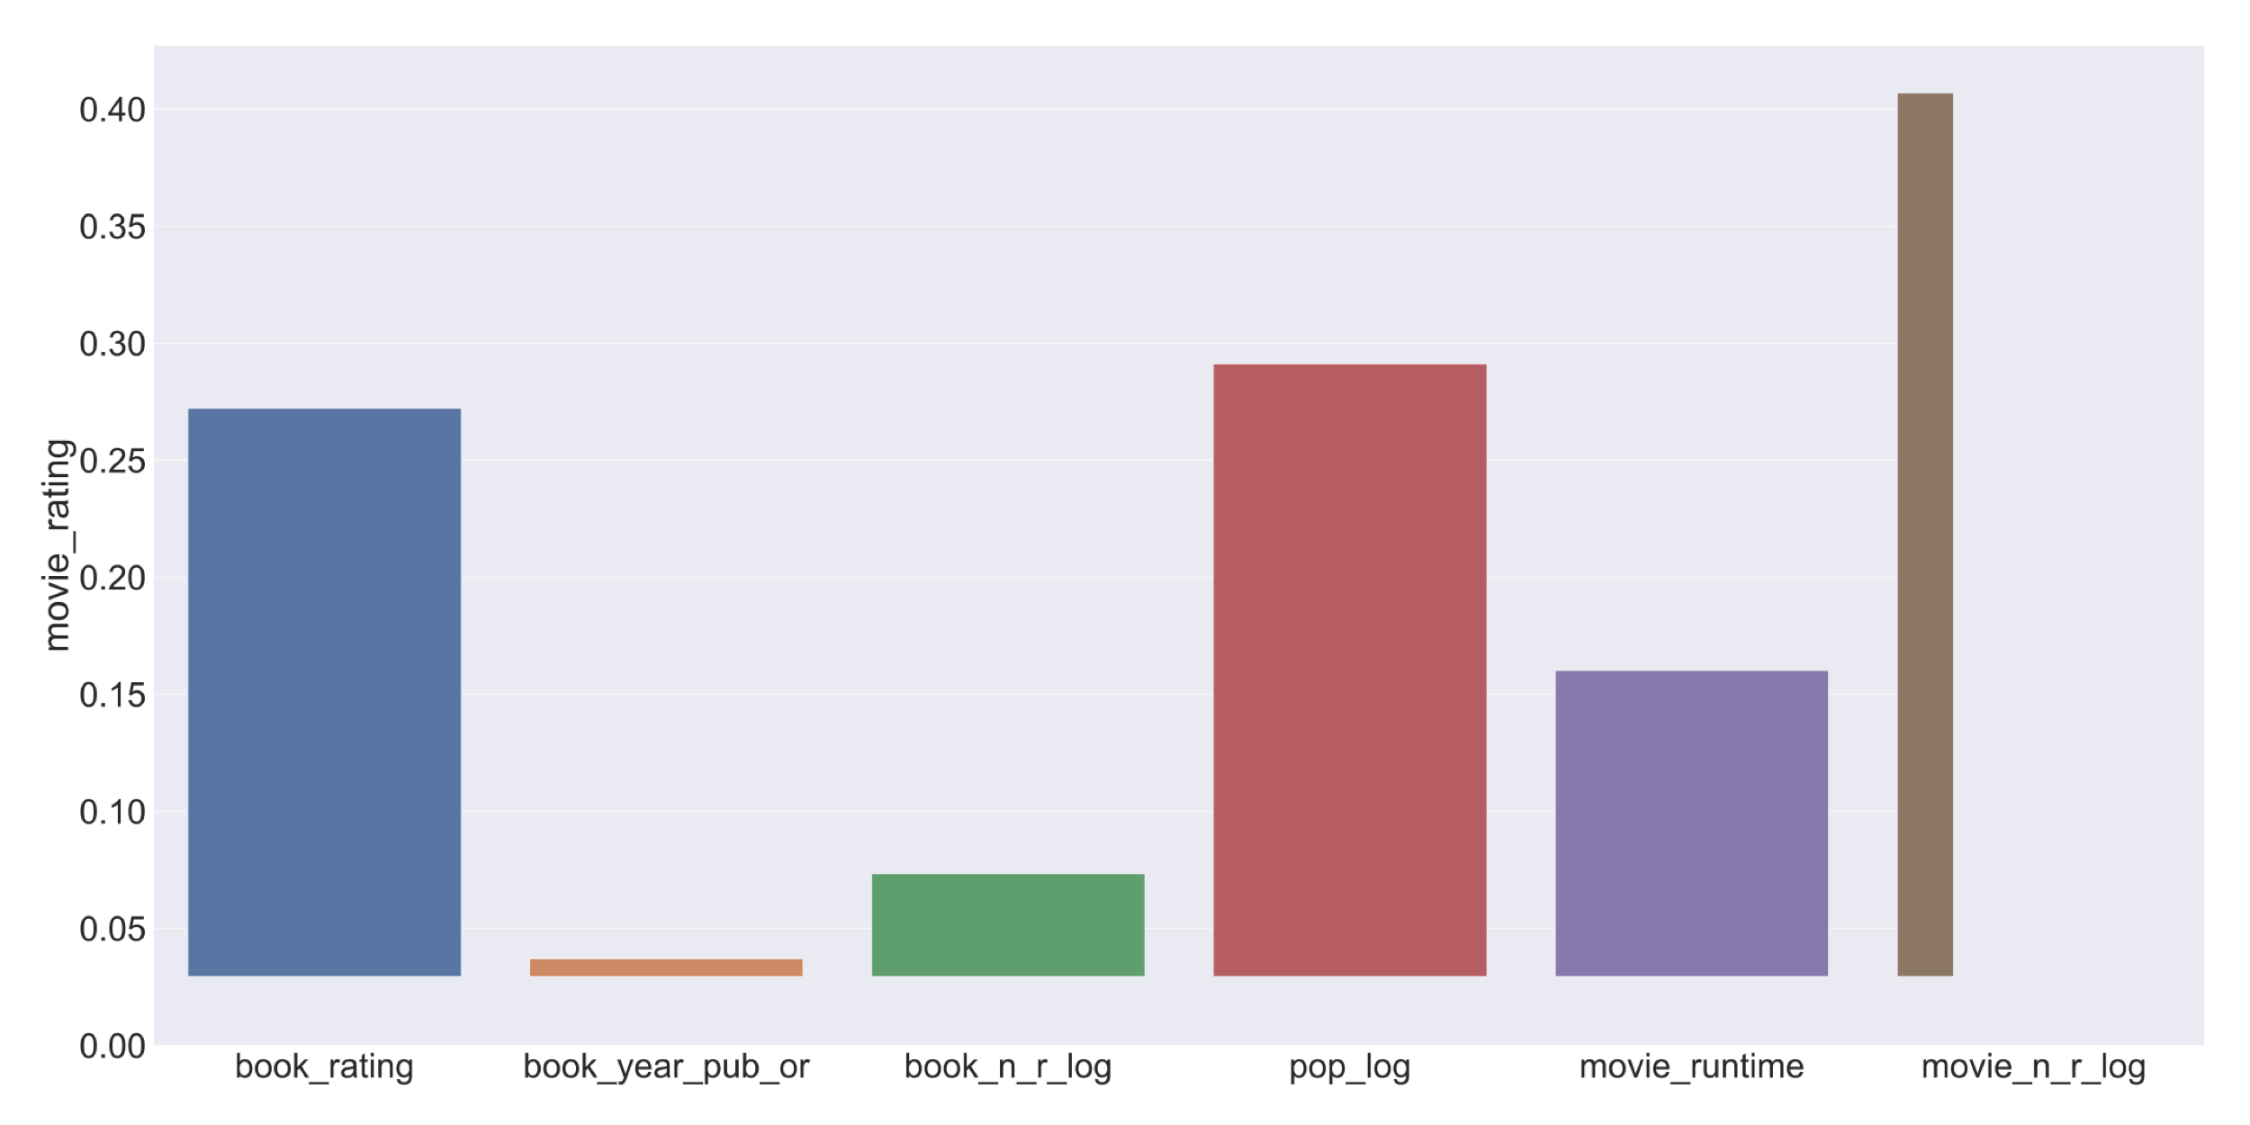
movie rating correlations
Awareness
Book
Rating
Popularity
Notes:
After examining the relationships, movie ratings appears to have a weak positive correlation with all the features, particularly book rating, popularity and awareness of the movie.

Slide 11
Insights - linear and ridge regression
Book versus Movie Ratings only:
Book rating explains about 7% of the variation
All the features – Linear and Ridge Regression:
Adj. R Square of ~ 0.25
Notes:
After performing linear and ridge regression analysis, I concluded that the book rating alone explains only about 7 % of variation in movie ratings. Combining the book rating with the rest of the features, the regression models explain only about 25 percent of the variation in the movie rating. Perhaps the regression model is not the best way to examine this relationship.
Root Mean Square Error (RMSE) of 1.08

Slide 12
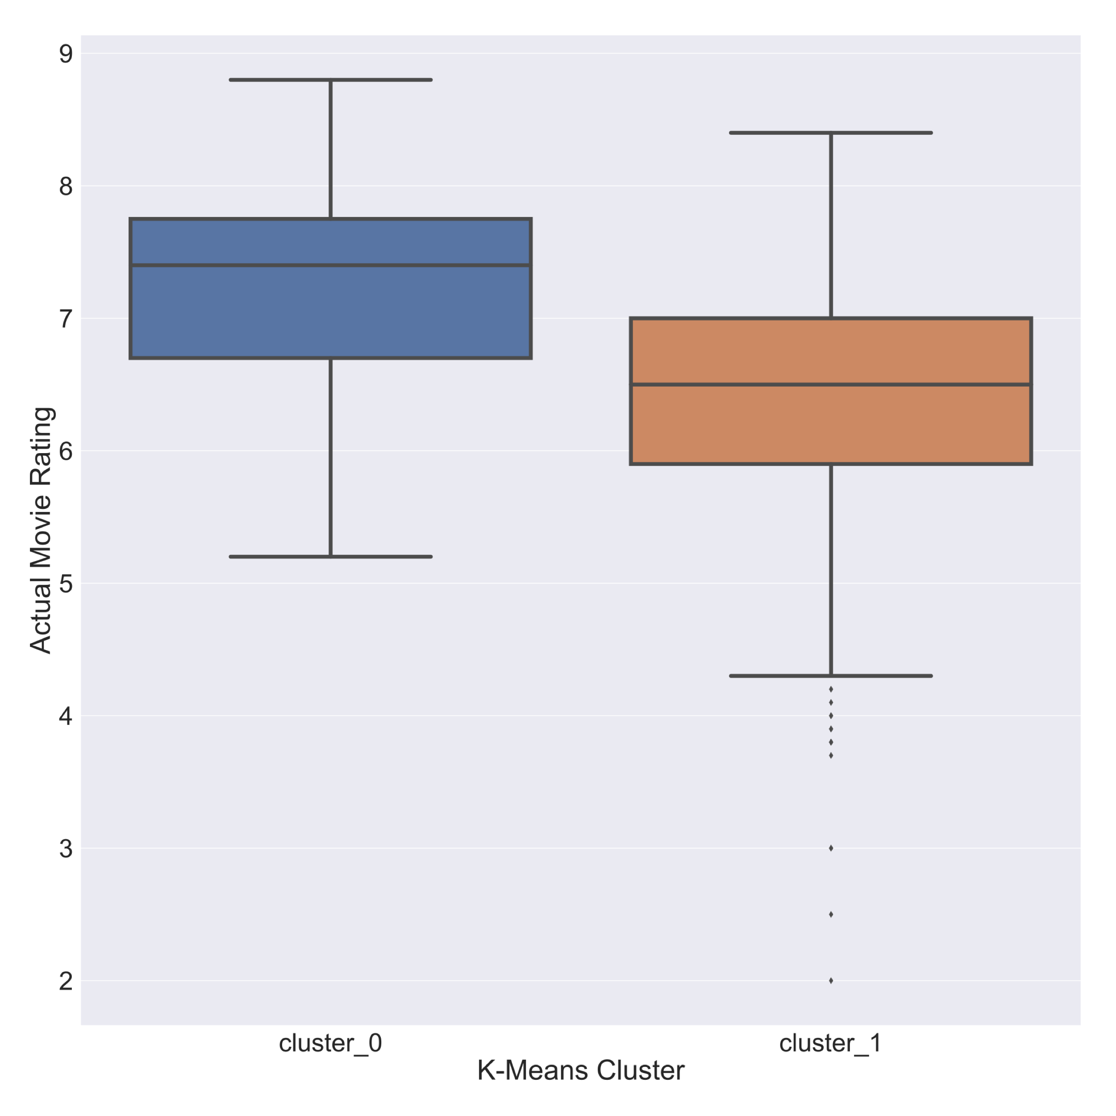
Insights – Cluster Analysis
Two clusters:
Silhouette coefficient of 0.5
Slightly better predictor for movie ratings
The Best
The Rest
Notes:
Using K-Means cluster analysis revealed a bit more of a relationship between book and movie success. The model was a bit better at separating the best movies from the rest.

Slide 13
Recommendations
Making movies from books:
Ensure the book is at least well-received AND moderately well-known
Best movies grow in popularity over time if well done
When making a movie based on a popular book:
Try to not disappoint the fans
Screenplay has to be able to stand alone

Slide 14
Future Efforts
Examine book versus movie sales
Over time
Different editions versus movie remakes
Social media impact of success versus notoriety
Notes:
Given more time, it would have been interesting to extract the sales figures for the books by edition, and track the evolution of book success over time. Same goes for the movies, as the same movie is often relaunched with more or less success than its predecessors.

Slide 15
Thank you!

Slide 16



Design and data acquisition
Book Data
Goodreads
Movie Data
IMDb
Analysis
MovieLens
Ridge Regression
Cluster Analysis
Notes:
When acquiring the data, I combined the information from Goodreads which yielded the book ratings and information about

Slide 17
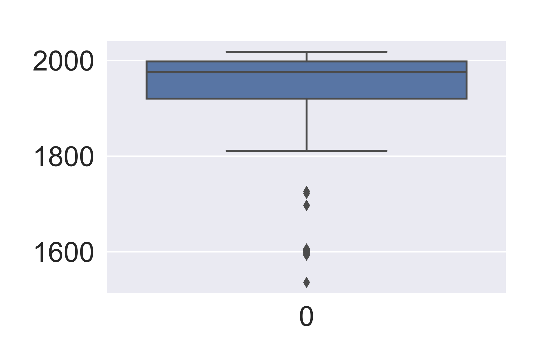
Transforming the Variables – Early Works
Notes:
After the initial look at the variables, discovered that several were highly skewed and needed to be transformed using the log transformation. For the books, there were several outliers in the year published column, notable Beowulf, published in 536, and several other classics. After adjusting those, and resolving the non-linear relationship between popularity and number of movie reviews, the dataset was ready for the analysis.

Slide 18
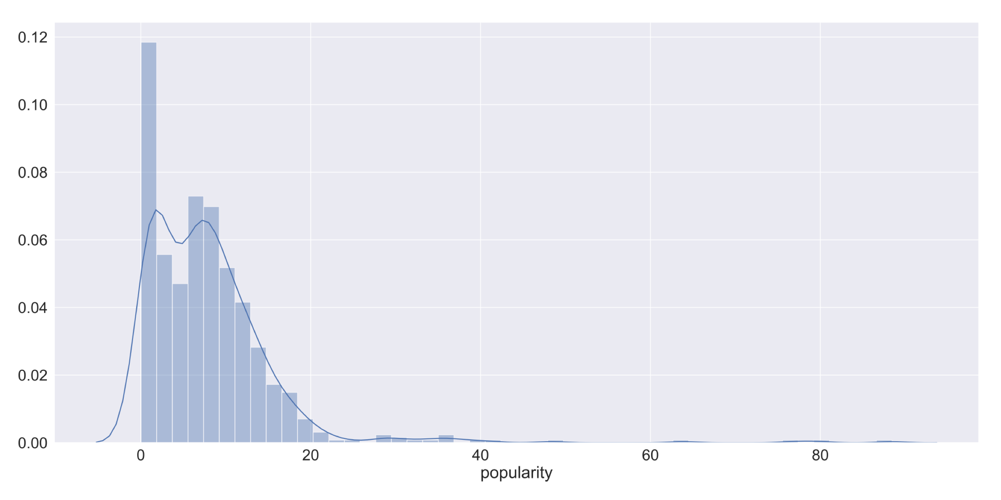
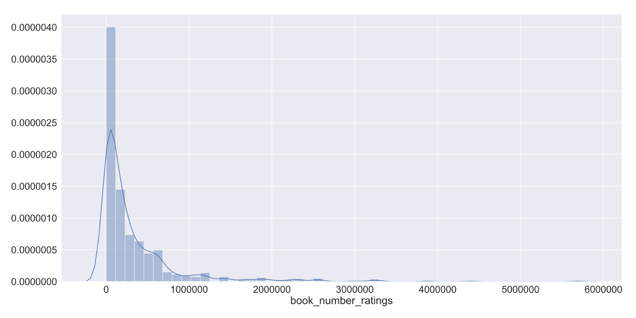
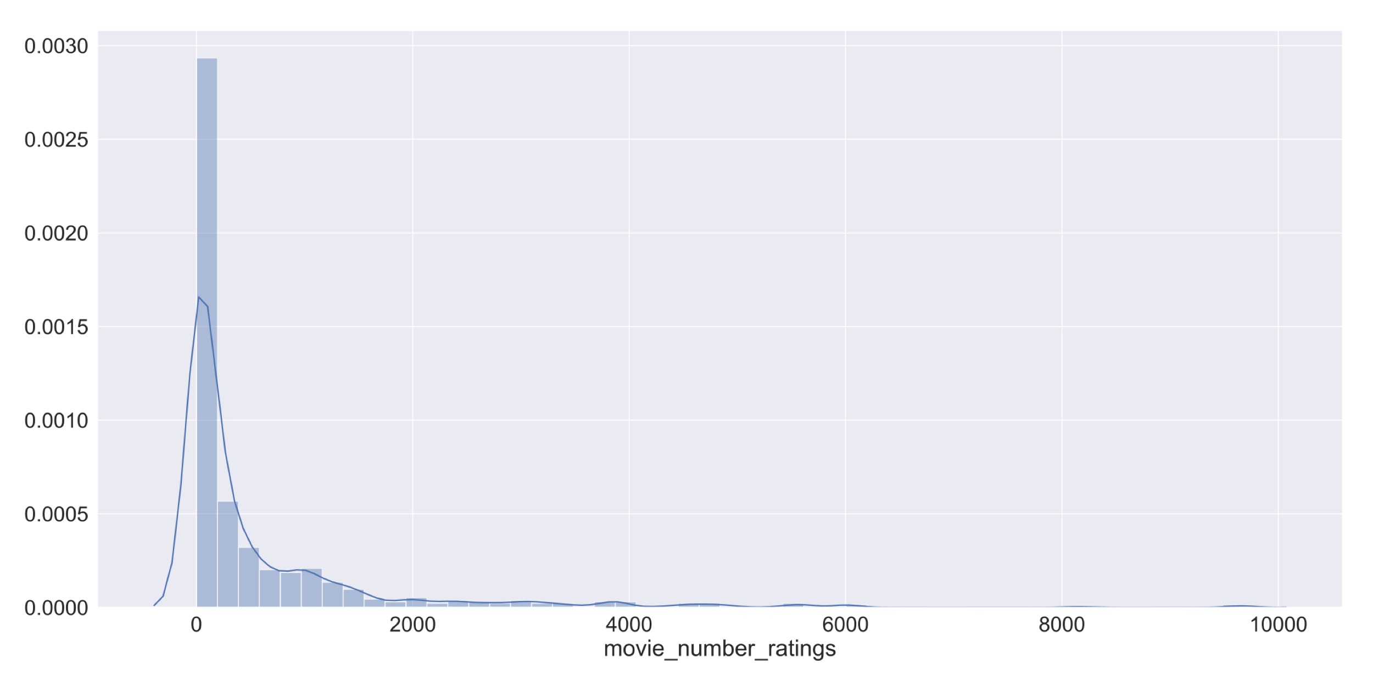
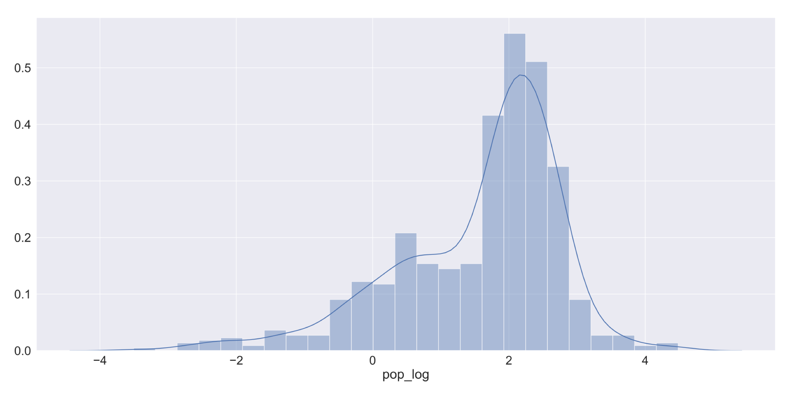
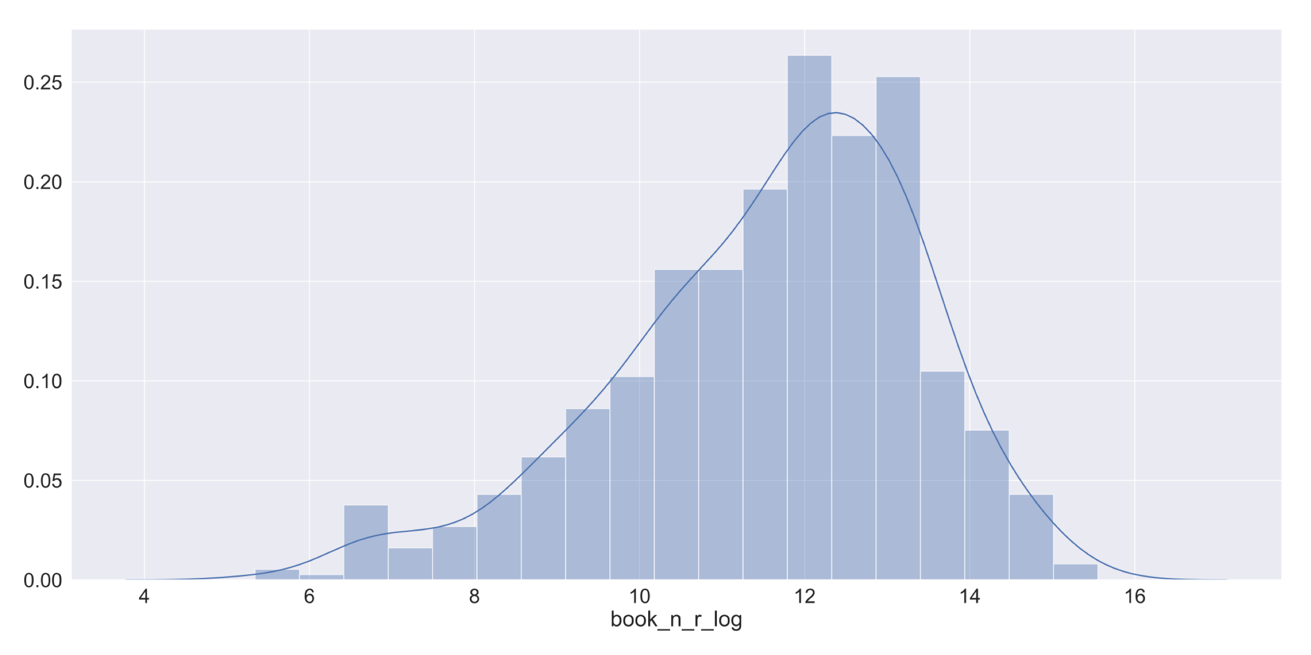
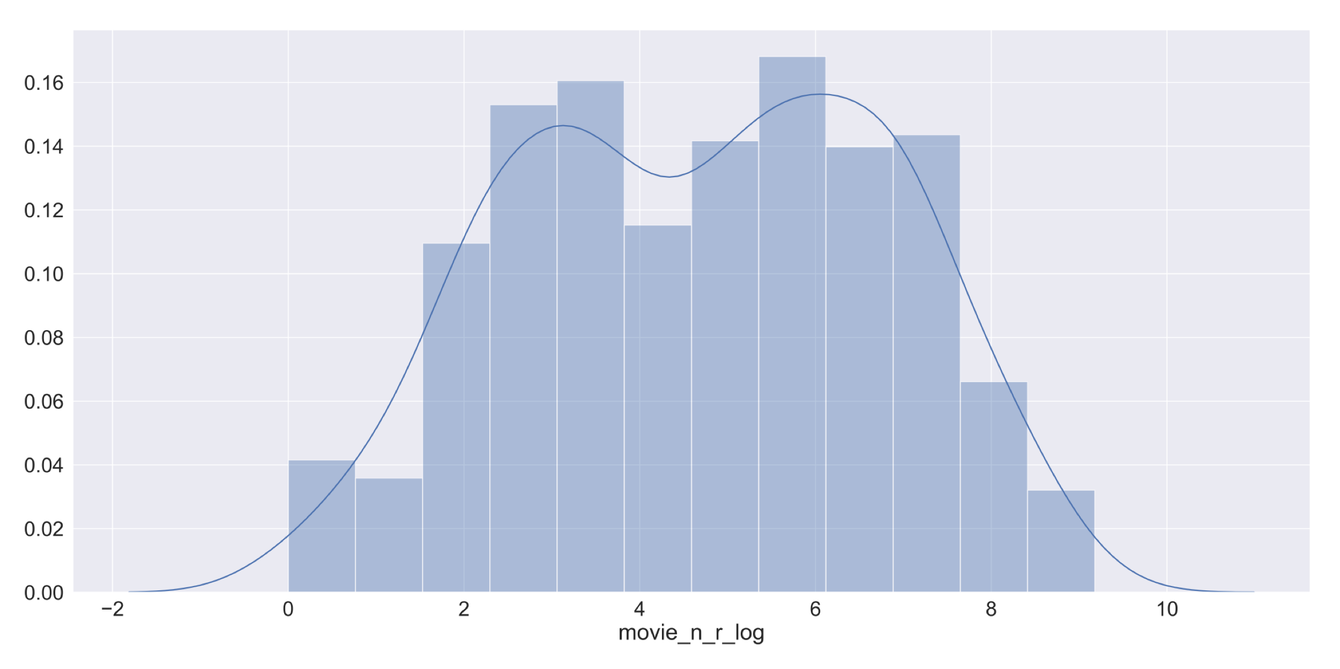
Feature engineering– log and poly transformations
Movie Popularity
Number of Book Ratings
Number of Movie Ratings
Notes:
After the initial look at the variables, discovered that several were highly skewed and needed to be transformed using the log and poly transformations.

Slide 19
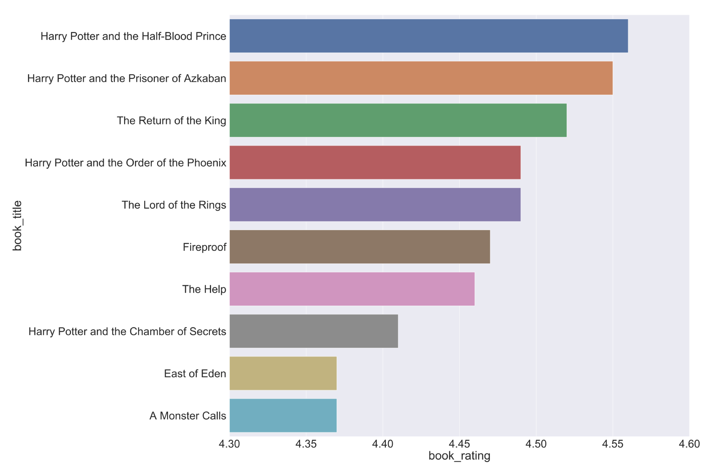

Slide 20
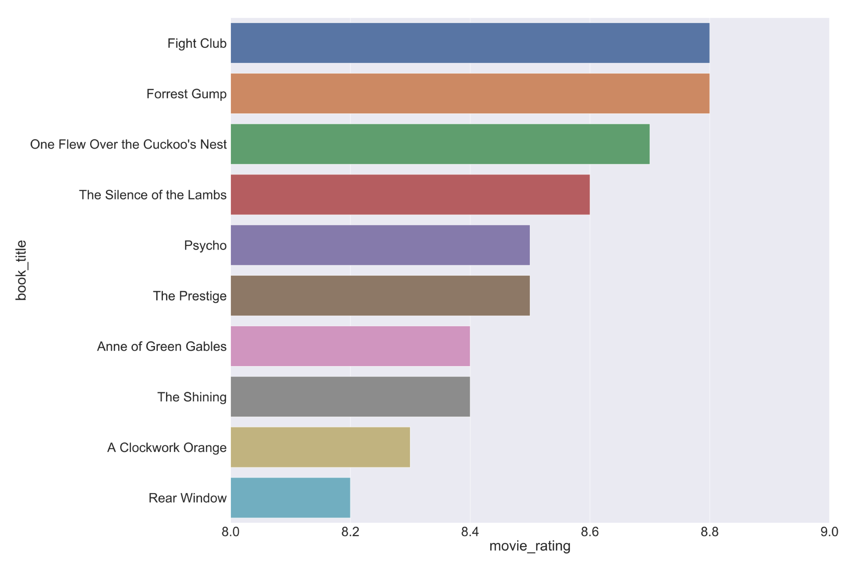

Slide 21
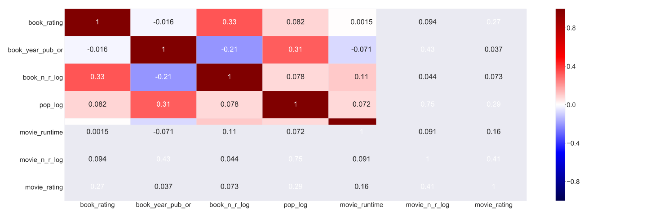
Features Correlation Map
Notes:
After examining the relationships, movie ratings appears to have a weak positive correlation with all the features, particularly book rating, popularity and the number of reviews.

Slide 22
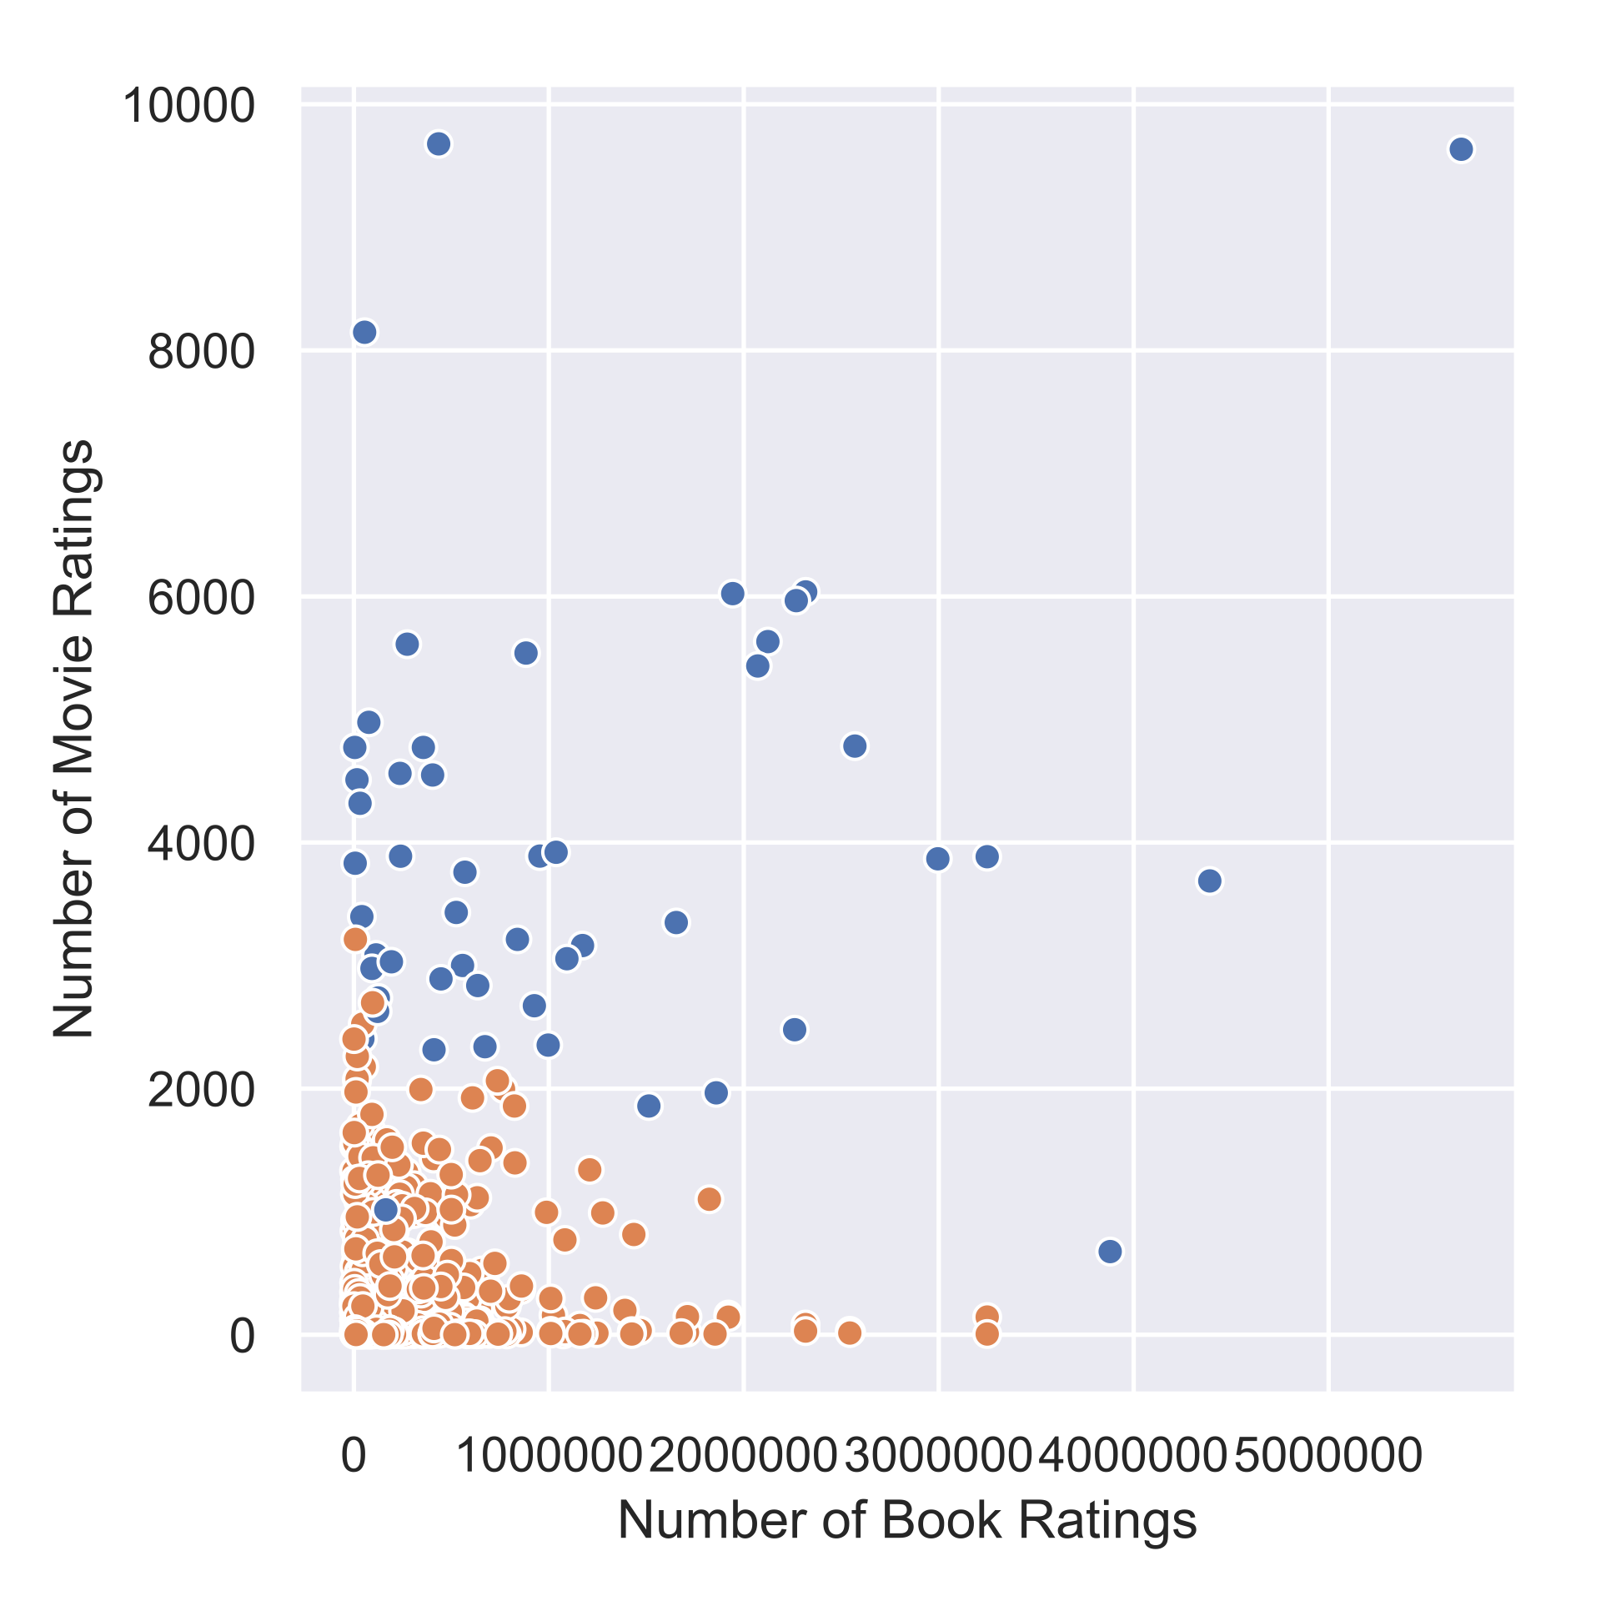
Insights – Cluster Analysis
Hunger Games
Two clusters:
Silhouette coefficient of 0.5 (range -1 through 1)
Slightly better predictor for movie ratings
Main split along the lines of lesser versus wider known
Notes:
Using K-Means cluster analysis revealed a bit more of a relationship between book and movie success. The model was a bit better at separating the best movies from the rest.
Using silhouette coefficient to evalualte quality of clustering
The Silhouette Coefficient is a common metric for evaluating clustering "performance" in situations when the "true" cluster assignments are not known.
A Silhouette Coefficient is calculated for each observation:
𝑆𝐶=𝑏−𝑎𝑚𝑎𝑥(𝑎,𝑏)SC=b−amax(a,b)
a = mean distance to all other points in its cluster b = mean distance to all other points in the next nearest cluster It ranges from -1 (worst) to 1 (best). A global score is calculated by taking the mean score for all observations.

